Slide 1
Sound recognition by Home AI assistant
30.10.2019
Katrina Bykova

Slide 2
Enhancing human interaction interface
Alexa and Google-home recognize voice commands when called
Current home AI systems do not “see” the home environment
The interaction with a human can be improved by adding environmental sensing
Can AI use sound to identify human activities?

Slide 3
Data source: Google AudioSet dataset
Collection of human-labeled 10-second sound clips from YouTube videos
2,084,320 recordings
527 sound classes:
speech
music
footsteps
…
Features preprocessed by VGGish acoustic model are available

Slide 4
Home-related activities: 10 sound classes
Cooking/cleaning
water
microwave
blender
vacuum cleaner
Entertainment
music
speech
clarinet
cat
Moving around
footsteps
opening doors

Slide 5
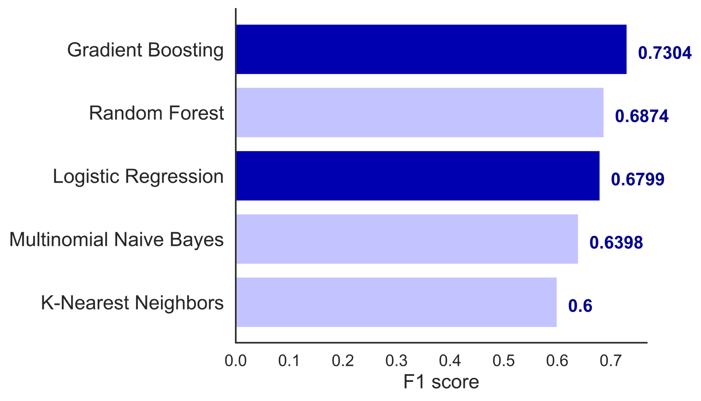
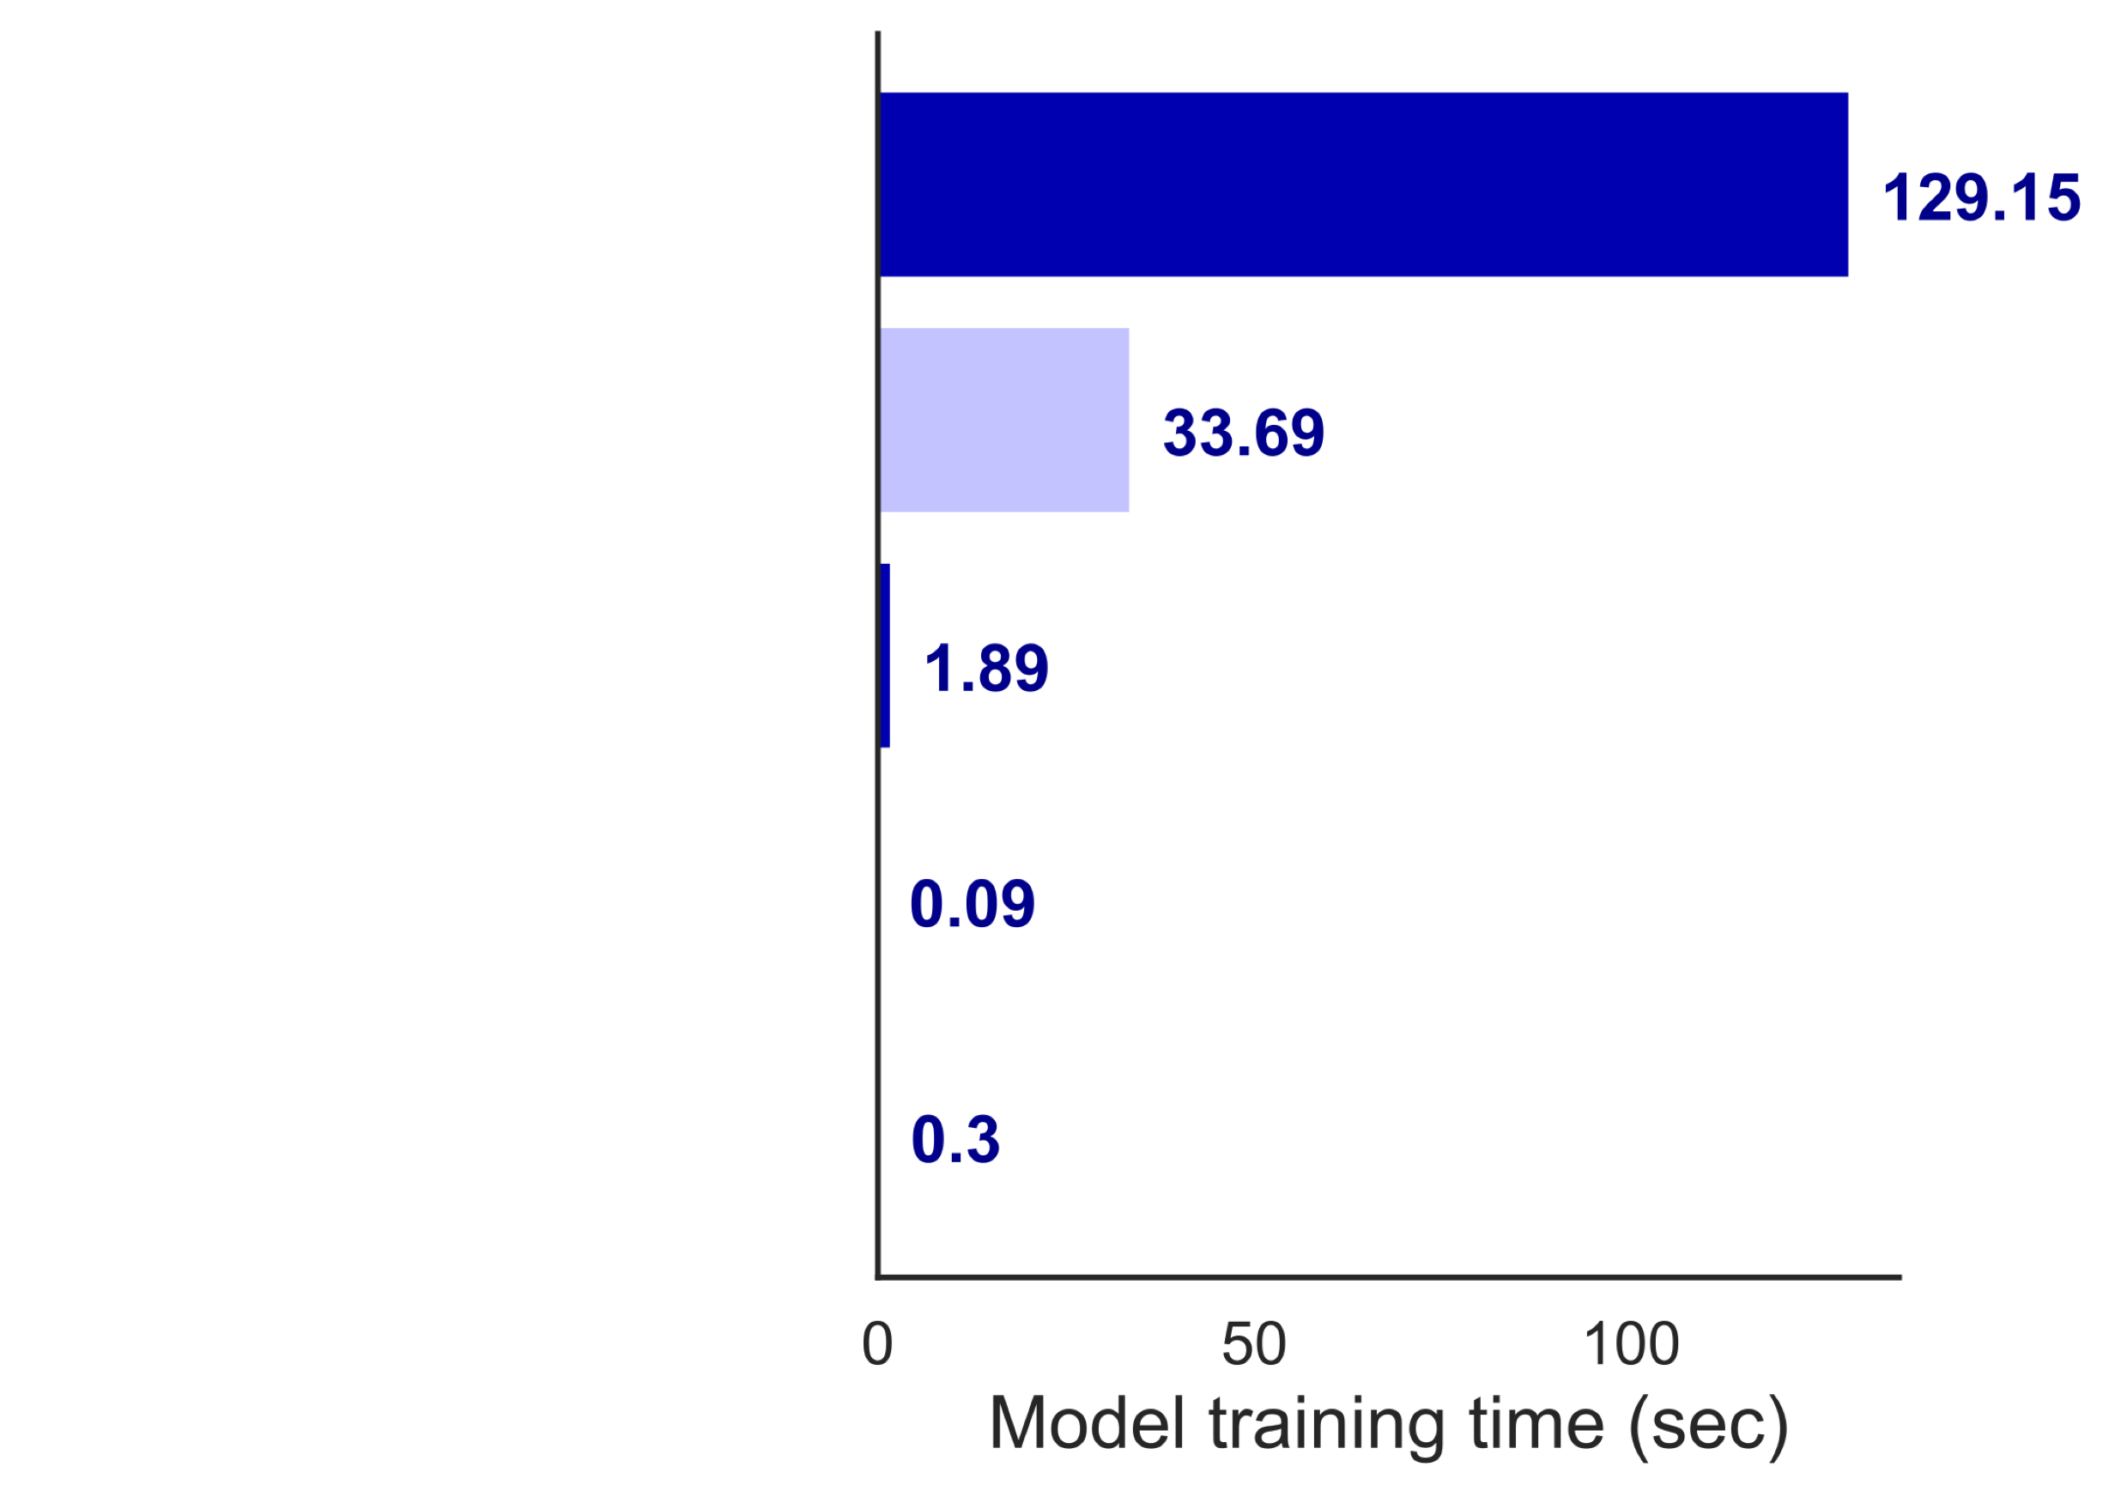
Sound recognition models
Model performance
Model training time
Gradient Boosting - best performance, longest model training time
Logistic Regression - less optimal performance, short model training time

Slide 6
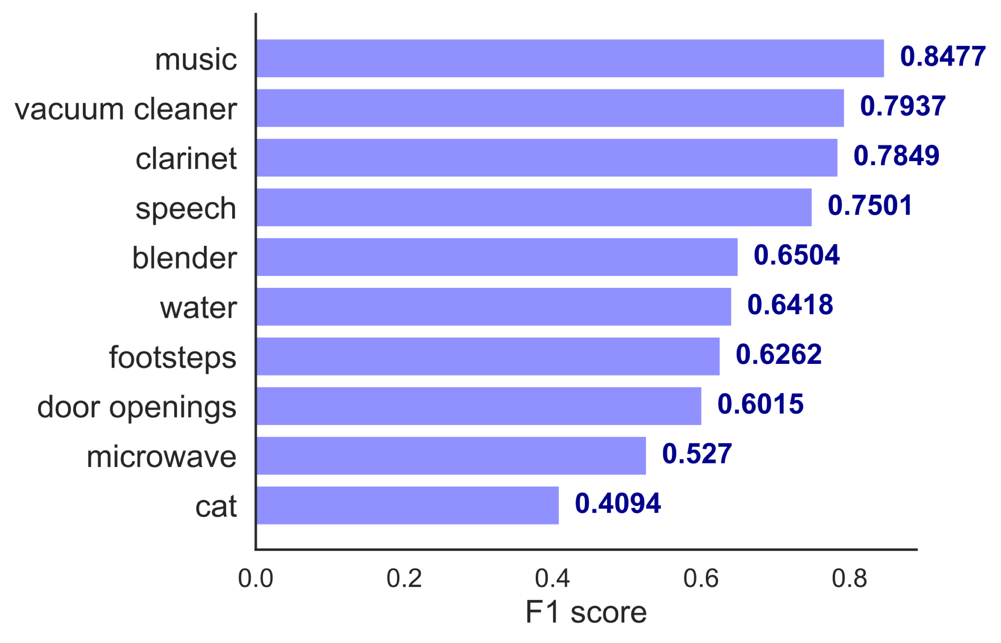
Recognition of individual sound classes
*
* Gradient Boosting model

Slide 7
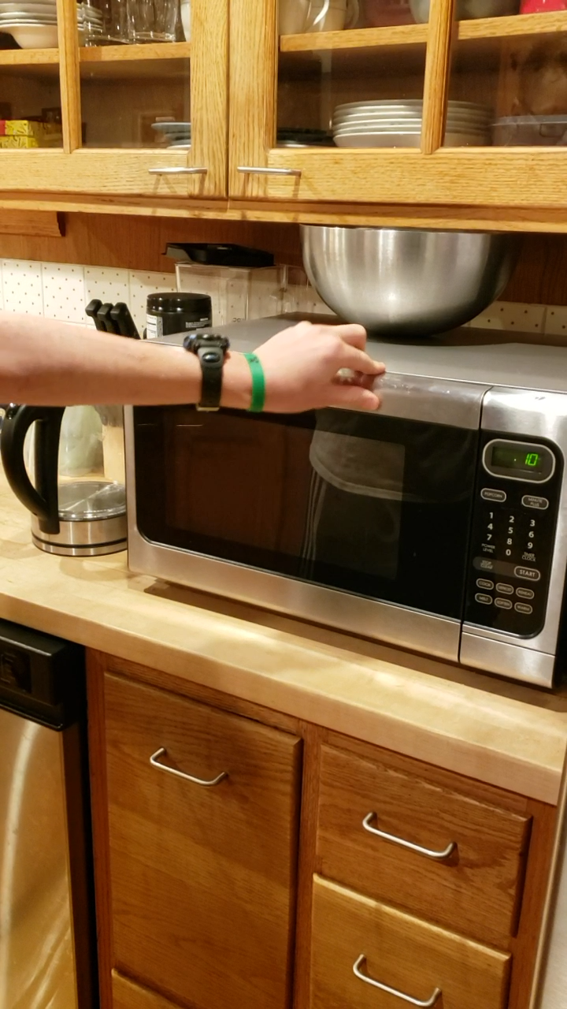
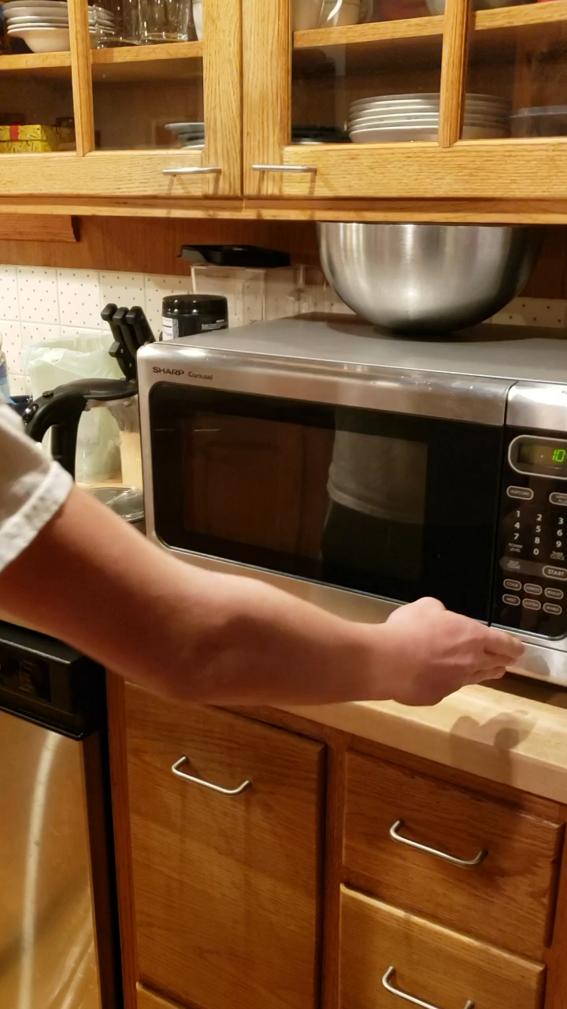
Recognition of home activities: examples

Slide 8
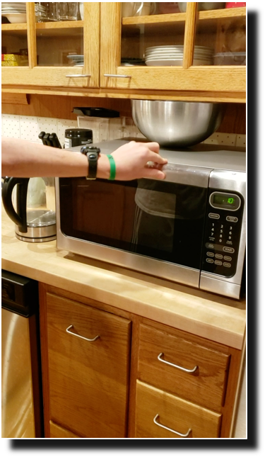
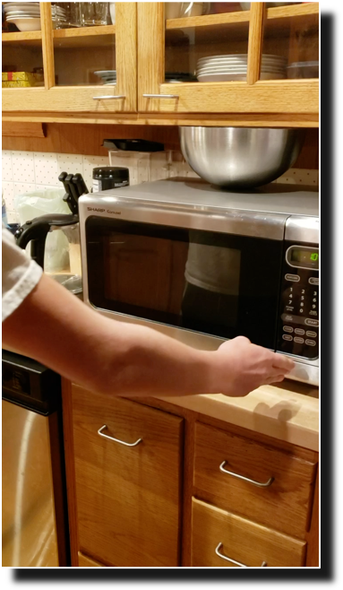
Recognition of home activities: examples
Adding additional observations to “microwave” and “blender” classes might help with the classification
microwave
blender
← model classification

Slide 9
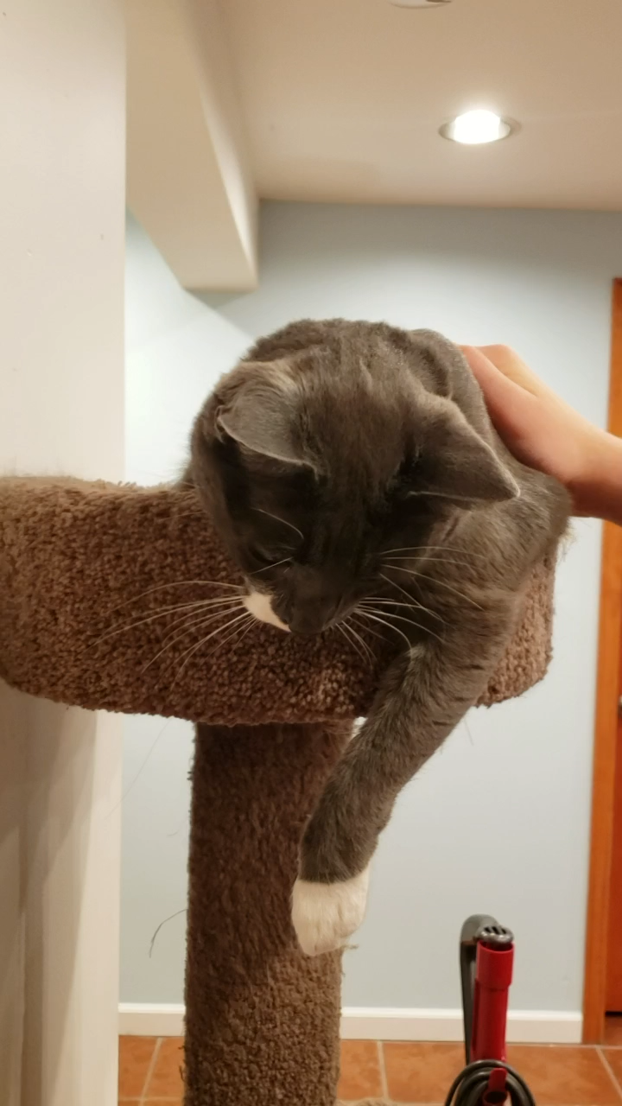
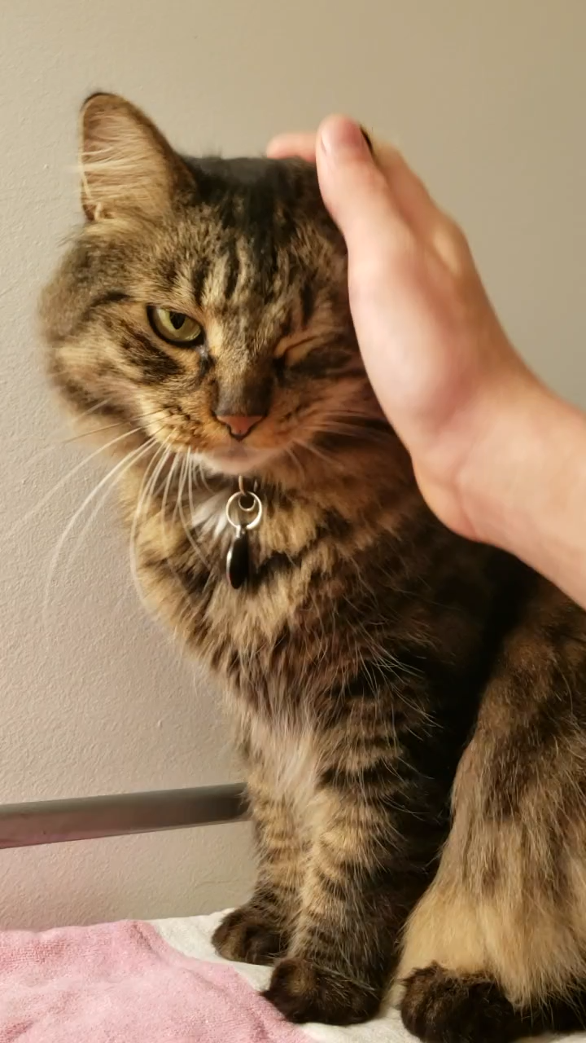
Recognition of home activities: examples

Slide 10
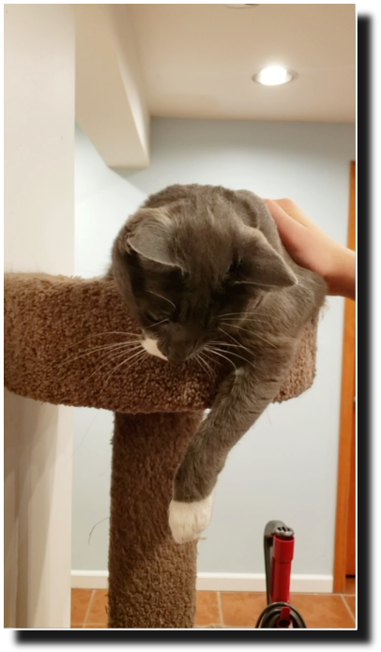
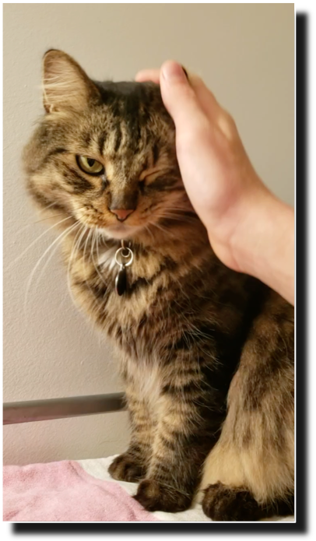
Recognition of home activities: examples
Training on ”human making cat sound” and “cat meow” sounds would help with the classification
cat ✓
cat ✕ → human voice

Slide 11
Conclusions
Home-related activities can be identified by AI through sound recognition
Recommendations:
Gradient Boosting model for the best performance
Logistic Regression for faster modeling time

Slide 12
Future development
Build Alexa skills
Children school morning AI assistant:
No “microwave sound” between 6:00 AM and 6:15 AM →
AI: “Have you packed your lunch?” Repeat every 5 minutes.
Repetitive ”cat” sound in the morning →
AI: “Please feed the cat.” Repeat until the “cat” sound is no longer registered.
Improve sounds recognition algorithm
Expend sound library
Develop alternative sound processing models

Slide 13
Sound recognition by Home AI assistant
Thank you

Slide 14
Sound recognition by Home AI assistant
Additional slides

Slide 15
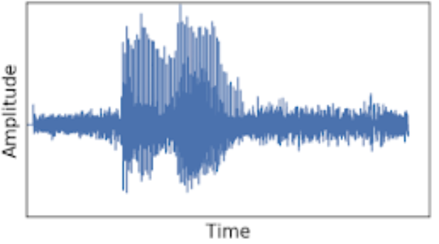
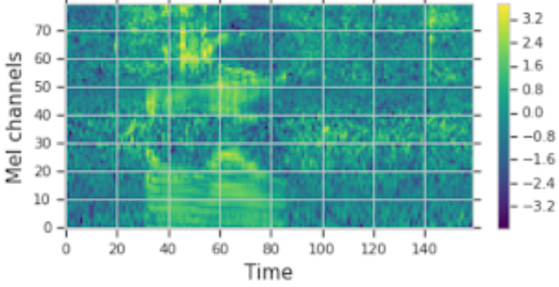
Home-related activities: 10 sound classes
Cooking/cleaning
water tap
microwave
blender
vacuum cleaner
Entertainment
music
speech
clarinet
cat
Moving around
footsteps
opening doors
Features:
sound
spectrogram
VGGish neural networks model
1,280 features

Slide 16
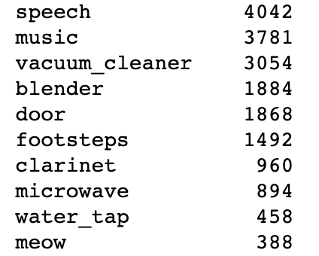
10 sound classes: observations

Slide 17
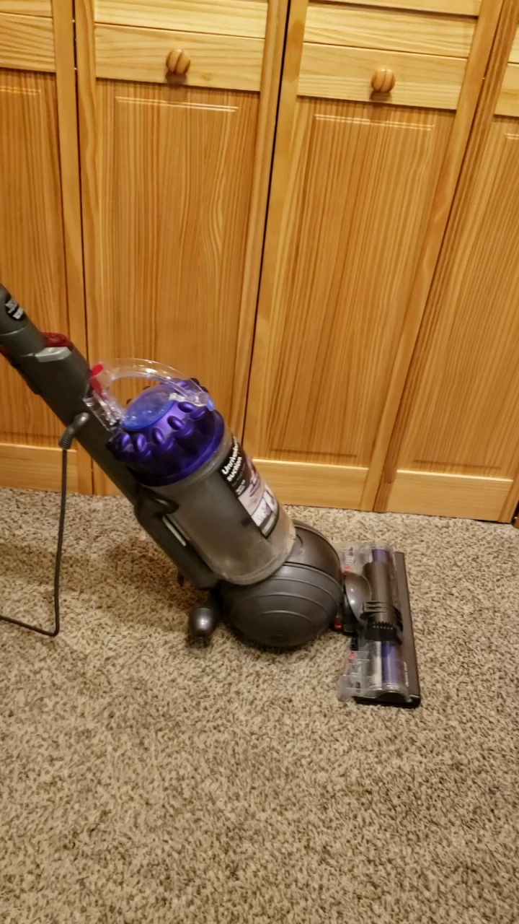
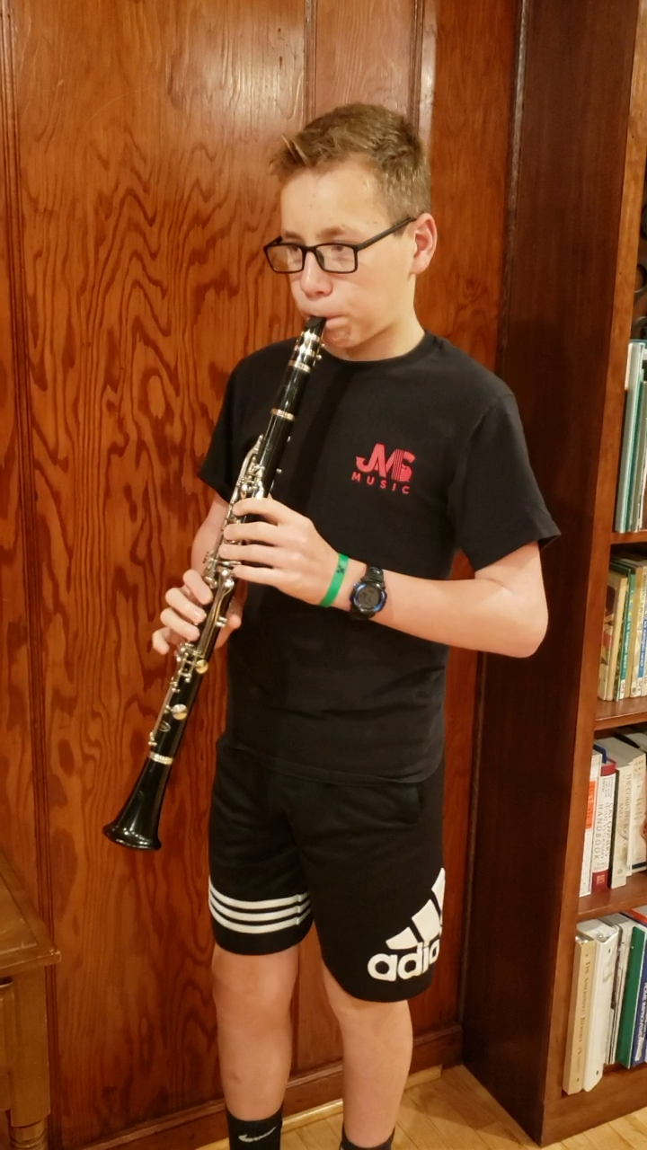
Recognition of home activities: examples
vacuum
cleaner ✓
clarinet ✓

Slide 18
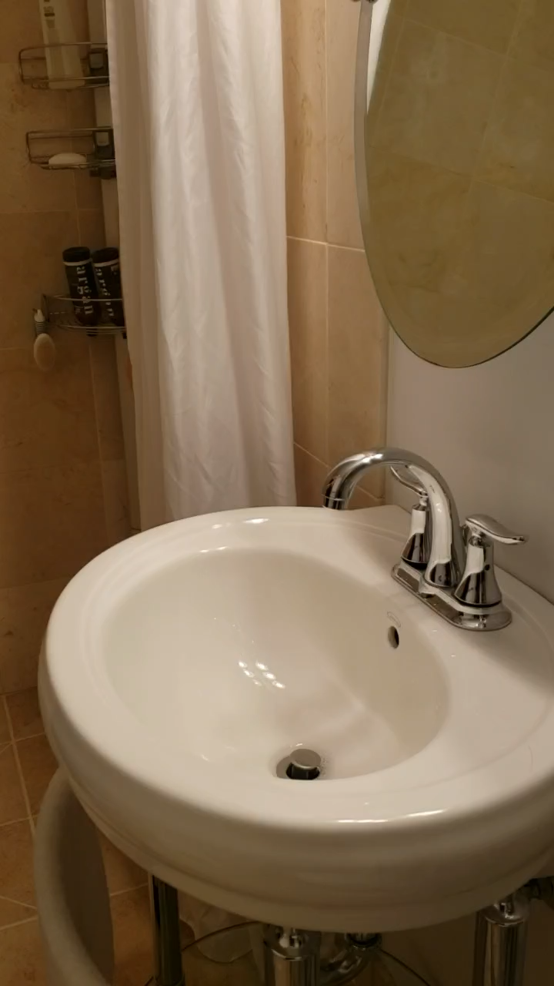
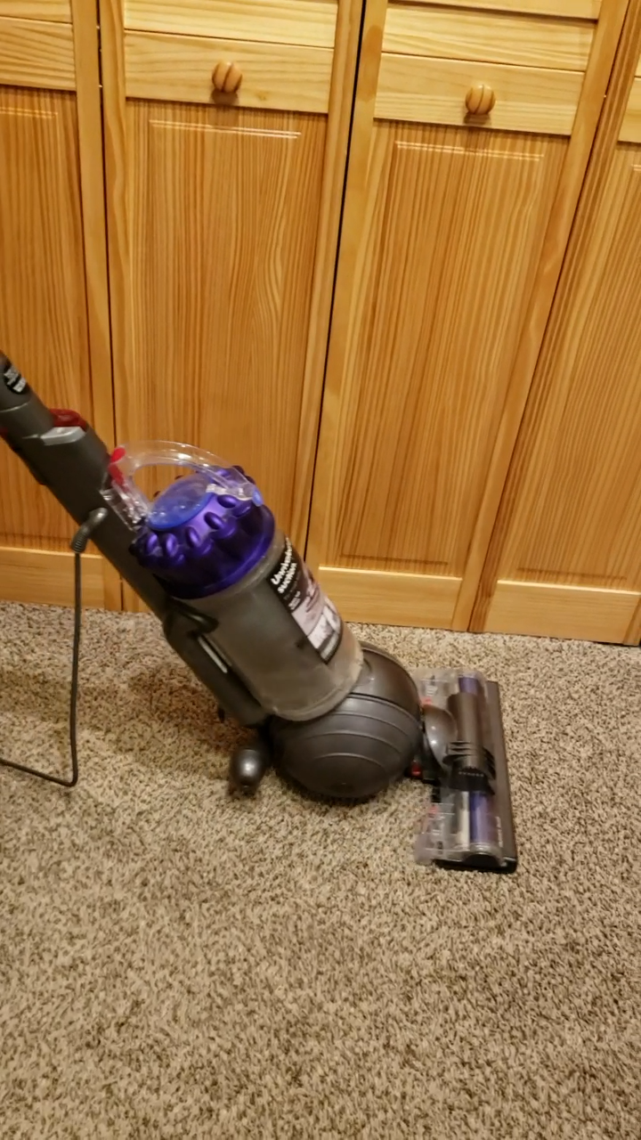
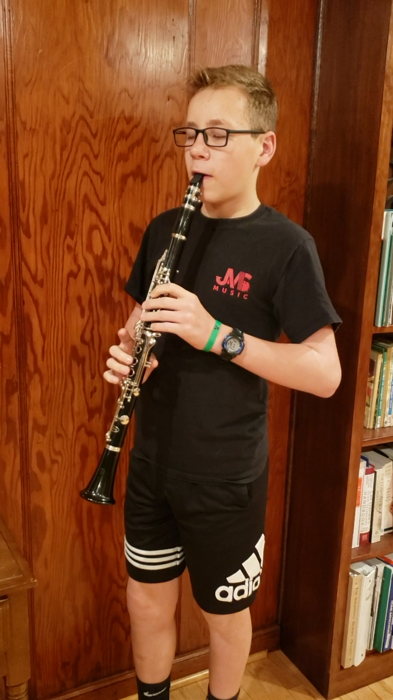
Recognition of home activities: examples

